Slide 1

RISK AND RESILIENCE BOOTCAMP
3

Slide 2


Slide 3
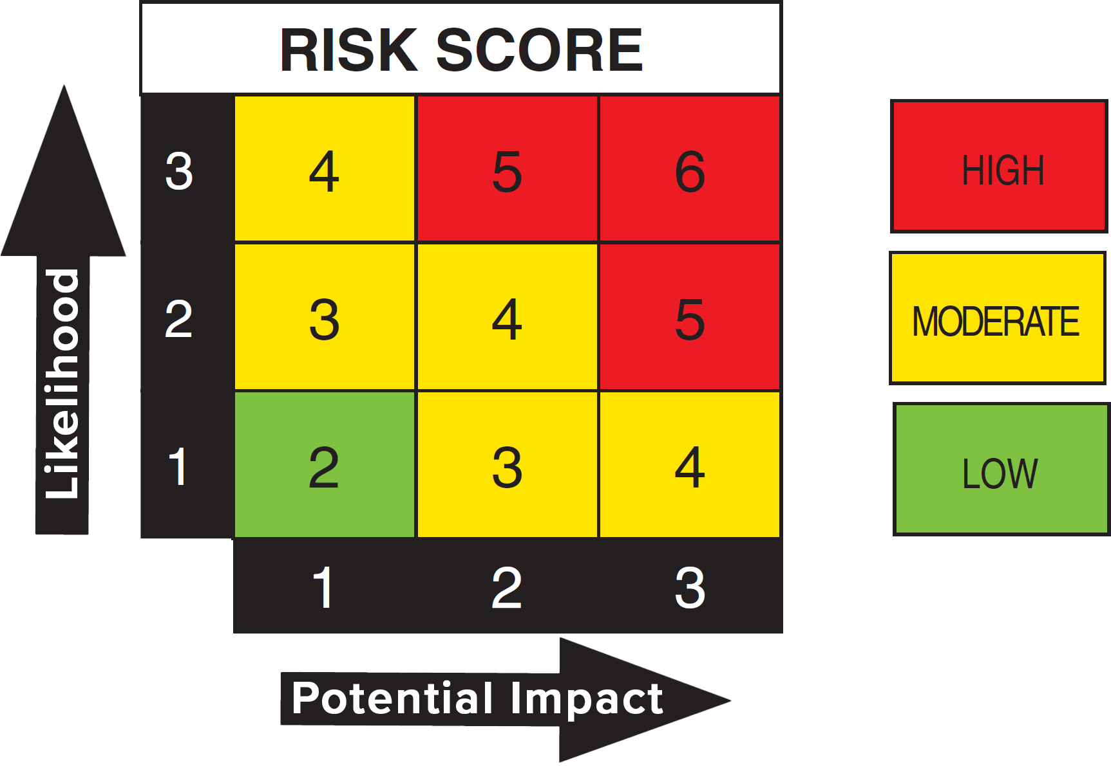
Risk scoring
This module introduces
Risk matrix review
Risk scoring
Risk formulas
Inherent vs residual risk

Slide 4
Rating Risk
Risk events are evaluated along two dimensions
Events have a probability of occurring
“The chance of a hurricane making landfall in Boston MA this year is very unlikely”
“There is a good chance a hurricane will make landfall in Florida this year”
Events have outcomes that tell us how negative the impacts of the events could be
Both dimensions can be quantitative or qualitative
“There is a 45% chance of a hurricane hitting Miami that would cause between $400 million and $800 million in property damage”
“There is a moderate chance of a hurricane hitting Miami that would cause high levels of property damage”
Qualitative measures are often good enough for informal risk evaluation
A primary goal of risk evaluation is to rank the severity of risks in order to prioritize which ones we should address first

Slide 5
Ranking risk
To prioritize risks
We have to “pick our targets”
We can’t do everything, so we will have to ignore some risks
The ones we ignore should be either very unlikely to occur or have a very minor impact
A typical assessment for risk occurrence is a set of ranked categories
Certain: it definitely will happen
Likely: the chance the event occurring is greater than it not occurring
Possible: even odds of it occurring
Unlikely: the chance the event occurring is less than it not occurring
Rare: the chance of it happening is very low
Eliminated: the event cannot occur

Slide 6
Ranking risk
An assessment for outcomes is also a set of ranked categories
Catastrophic: death or permanent total disability, significant irreversible environmental impact, total loss of equipment
Critical: accident level injury resulting in hospitalization, permanent partial disability, significant reversible environmental impact, damage to equipment
Marginal: injury causing lost workdays, reversible moderate environmental impact, minor accident damage level
Minor: injury not causing lost workdays, minimal environmental impact, damage less than a minor accident level
If there is no negative outcome when the event occurs
Then there is no risk because the event has no impact
Once there are rankings of the likelihood and outcome
We can classify the overall risk of the event
Usually taken as the informal product of the two rankings
Often represented by a risk matrix

Slide 7
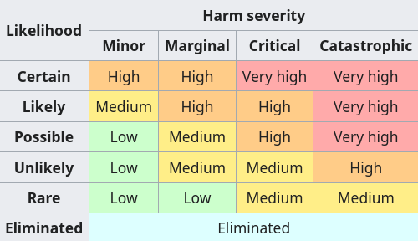
Risk matrix
Each risk can now be prioritized
The very high risks are dealt with first
These events are certain or likely to happen and will have severe negative impacts
These generally need to be done urgently
We might not manage with the low risks
We can prioritize management of the mid-range risks based on other criteria
For example, costs of a high risk mitigation may have to be deferred because of costs
Or a medium risk may be deferred because the skill sets to mitigate it might not be available.
Establishes a way to triage risks

Slide 8
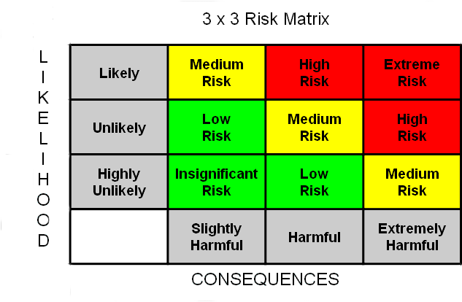
Common risk matrices
A risk matrix is a visual tool
There is no official format
On the right is a common 3x3 form
The example is qualitative
Useful as a first analysis
Often uses historical data and expert opinions to come to a preliminary decision

Slide 9
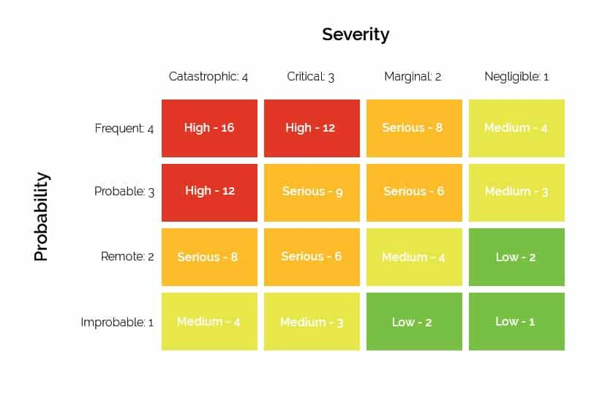
Common risk matrices
Another variant is the 4x4
This matrix assigns a numerical value for both probability and severity
This produces a risk score ranging from 16 (4 x 4) to 1 (1 X 1)
This is still qualitative
The values are not computed from data
They are still ordinal
Often used to support automation and data analysis

Slide 10
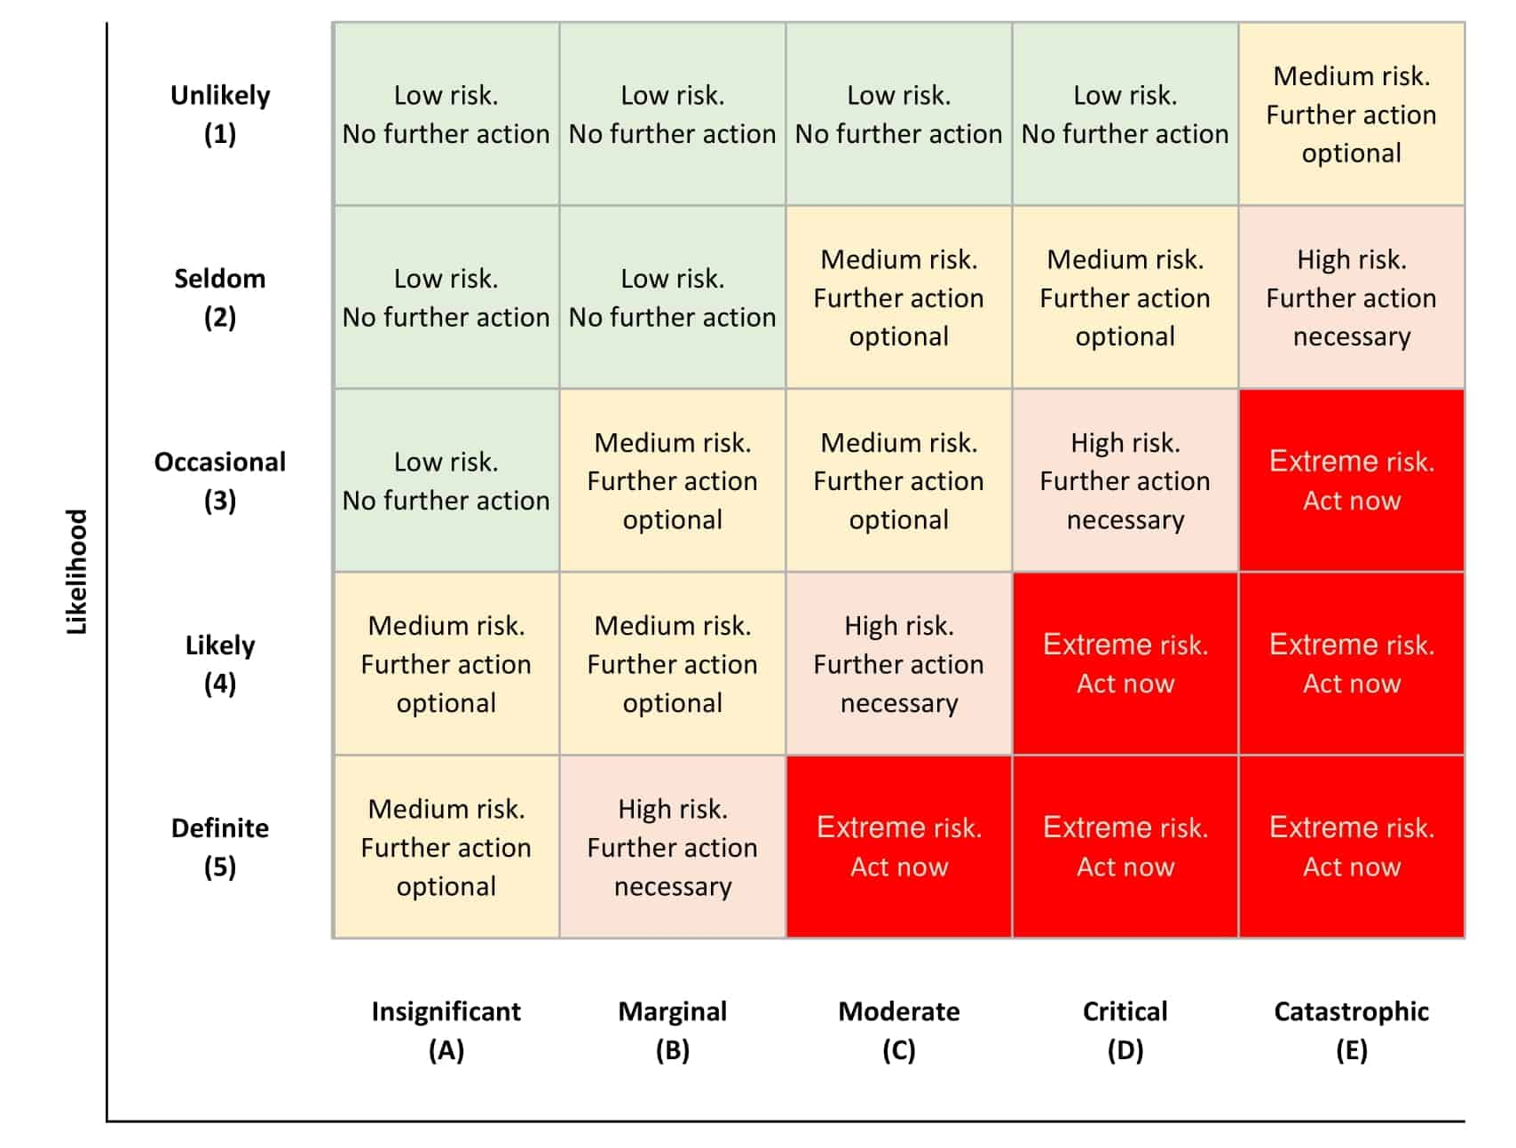
Common risk matrices
This is a 5x5 matrix
Incorporates a risk management decision to prioritize responses
These examples show there is no “correct” form of a risk matrix
They all express the idea of computing risk as a combination of likelihood and outcome
The actual risks will depend on how we choose to define and classify them
That is what we need to get right in a risk assessment

Slide 11
Quantitative risk matrices
Quantitative matrices use data to assign the frequency and outcome values
These values are derived from existing data
Often based on some mathematical model; a regression analysis for example
The model might incorporate
Analyses of historical data to predict the likelihood of an event
This could be expressed as a probability of the event occurring
A set of impacts on affected populations based on historical occurrences
For example, historical records of the dollar value of damage for similar events
Results in a more comprehensive description of the risk
The next page shows a quantified risk matrix from the liquid natural gas industry
No matter how detailed or precise the risk matrix is
It doesn’t tell us how to manage risk or reduce the risk
Requires a standard set of concepts, procedures and strategies for responding to risk

Slide 12
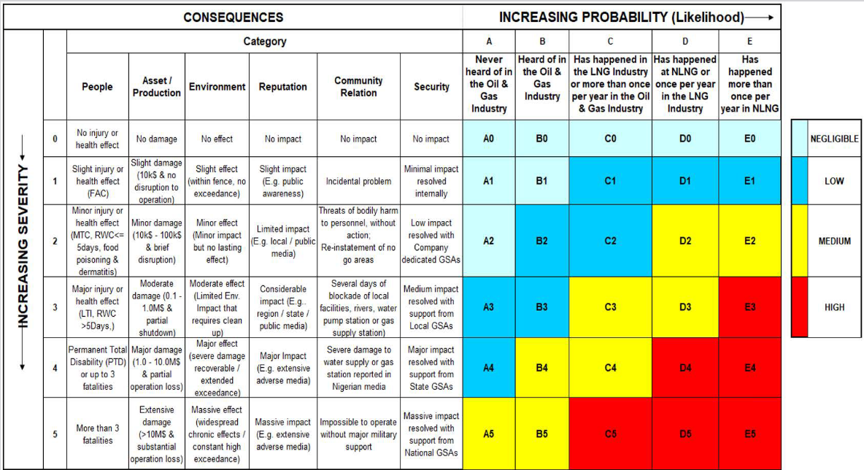
LNG risk matrices

Slide 13
Risk matrix
Purpose of a risk matrix
Provides a visual summary of organizational risk exposure
Helps rank risks for treatment and monitoring
Enables stakeholder discussions by offering a common language
Useful when quantitative data are limited, such as strategic or emerging risks
How it works
Identify a risk scenario
Assign a likelihood rating (1–5)
Assign an impact rating (1–5)
Cross-reference in the matrix
Determine the risk score and risk zone

Slide 14
Risk Scoring
Assigning numeric values to likelihood and impact to produce a combined score for prioritization
Likelihood - probability dimension
Likelihood captures the chance that the risk will materialize
It may reflect:
Historical frequency
Scenario analysis
SME judgment
Threat intelligence
Detection or failure rates

Slide 15
Risk Scoring
Likelihood - probability dimension
Common 5-level descriptions:
Rare
Unlikely
Possible
Likely
Almost Certain
Likelihood may be expressed qualitatively (label) or semi-quantitatively (numeric mapping)

Slide 16
Risk Scoring
Impact estimates the consequences if the risk occurs
Impact can be financial or non-financial:
Monetary loss
Reputational damage
Health and safety harm
Regulatory penalties
Operational downtime
Typical 5-level impact scale:
Negligible
Minor
Moderate
Major
Catastrophic

Slide 17
Risk Scoring
Risk scoring formula
A common approach is
Risk Score = Likelihood × Impact
Example: Likelihood (4) × Impact (5) = 20
Scores are placed into categories such as
1–5: Low
6–15: Medium
16–25: High
This facilitates risk prioritization by grouping similar scenarios

Slide 18
Risk Scoring
Uses of risk scoring
Ranking risks for mitigation or investment
Supporting risk committees in decision-making
Triggering escalation thresholds
Simplifying complex discussions
Tracking changes over time (heat map movements)
Limitations of risk scoring
Numeric values suggest false mathematical meaning (e.g., 4×5=20 is not “twice as risky” as 2×5=10)
Likelihood and impact scales are ordinal, not ratio scales, meaning the intervals are not equal
Assigning numbers does not make qualitative judgments quantitative

Slide 19
Inherent Risk vs. Residual Risk
Inherent risk
The level of risk before applying any controls, safeguards, or mitigation
It reflects a “raw” scenario assuming
No controls exist, or
Controls are completely ineffective
Purpose of inherent risk
Understanding the natural exposure of a process or system
Prioritizing high-threat areas before analyzing controls
Supporting resource allocation to high-exposure domains

Slide 20
Inherent Risk vs. Residual Risk
Residual risk
The level of risk that remains after controls have been applied
Controls may include:
Preventive (firewalls, access controls)
Detective (monitoring, logging)
Corrective (backup restoration, disaster recovery)
Procedural (policies, training)
Purpose of residual risk
Determining actual exposure after mitigation
Ensuring risk is within risk appetite or tolerance
Supporting decisions on whether additional controls are needed

Slide 21
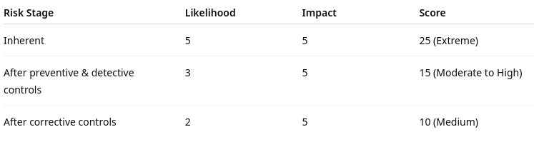
Inherent Risk vs. Residual Risk
How to estimate inherent vs. residual risk
Typical approach:
Evaluate inherent likelihood and impact
Identify relevant controls and assess their effectiveness
Adjust likelihood and/or impact downward to derive residual risk
Compare inherent vs. residual risk positions in the matrix

Slide 22
Pitfalls and Limitations
Risk matrices can have significant limitations
False precision
Assigning numbers (1–5) to qualitative judgments creates the illusion of mathematical validity
A “4” likelihood may be interpreted as objectively higher than a “3” likelihood instead of expressing an opinion
A risk score of 20 is not necessarily “twice as severe” as a score of 10
Scale intervals are unequal and subjective
This creates pseudo-quantification, which can mislead stakeholders
Ordinal scale problems
Likelihood and impact categories are ordinal, not interval scales.
You cannot meaningfully add, multiply, or average them
Risk scoring formulas (L × I) are mathematically invalid, but still widely used

Slide 23
Pitfalls and Limitations
Matrix distortion effects
Risk matrices often distort results because
The boundaries between categories are subjective
Risks of different natures can end up with the same score.
Visual placement may hide critical tail-risk scenarios
Example:
A low-frequency, catastrophic event may be scored the same as a high-frequency, moderate event, even though their real implications differ dramatically
Inconsistent SME judgments, qualitative matrices depend heavily on:
SME memory
Personal experience
Organizational culture
Introduces variability and cognitive bias, such as anchoring, availability, and optimism bias

Slide 24
Pitfalls and Limitations
Loss of uncertainty information because mtrices force one value for likelihood and one for impact, eliminating
Ranges
Distribution shapes
Confidence levels
Quantitative methods (like Monte Carlo or FAIR) retain uncertainty, whereas matrices compress everything into a single static box
Poor support for decision-making in high-stakes environments
For capital allocation, insurance decisions, business continuity planning, or cyber budgeting, matrices:
Lack financial interpretation
Cannot model tail risks
Provide insufficient detail to justify large investments

Slide 25
Pitfalls and Limitations
False sense of objectivity
The color-coded output appears authoritative, but it often:
Reflects subjective opinion
Lacks statistical basis
Oversimplifies complex systems
Risk matrices work best as communication tools, not for rigorous measurement

Slide 26

Q&A and open discussion
Notes:
Now is the time to engage in an interactive Q&A session where you can ask questions, share insights, and clarify any doubts about the topics we have covered so far.
This open discussion is designed to ensure that every participant has the opportunity to voice their thoughts and learn from the collective experience of the group.
Your questions and comments are valuable as they help us identify areas that may need further explanation and enable us to tailor future sessions to your needs.
We encourage you to speak up and contribute to the dialogue, as this interaction is one of the key components of our interactive learning approach.
As the session progresses, take note of any questions or ideas that you would like to revisit, and feel free to share your perspectives with the class.

